Slide 1

Vulture mine tailings
Nicolas Boon
Audrey Lang
Nicole Stanczak

Slide 2
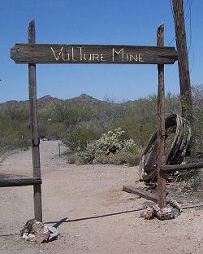
Presentation Overview
1. Project Understanding
2. Scope of Services
3. Project Schedule
4. Cost of Engineering Services
Figure 1. (Source: Sherrod, Christina)
Audrey Lang

Slide 3
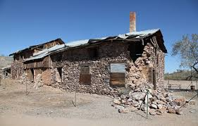
1. Project Understanding
1.1 Introduction and Background
1.2 Client, Technical Advisor, Stakeholders
1.3 Project Description
Figure 2. (Source: Western Mining History)
Audrey Lang

Slide 4
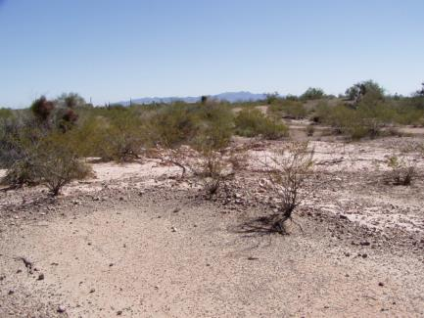
1.1 Introduction & background
Wickenburg, Arizona
Gold mine
  1863- Operation began
  1942- Mine closed
Mined by open-cut methods
  Treatment: Cyanide leaching and flotation
Tailing migration
  Cloudbursts
  Entered into a wash south of the mine
Figure 3. (Source: Plis, Matt BLM)
Audrey Lang

Slide 5

1.2 Client, Tech advisor, stakeholders
Client
  Bureau of Land Management (BLM)
  Mr. Matt Plis
  Dr. Bill Harris, PhD, PE
Technical Advisor
  Dr. Bridget Bero
Stakeholders
  BLM
  United States and Arizona Citizens
Figure 4. (Source: Nixon, Nicole BLM)
Nicole Stanczak

Slide 6
1.3 Project Description
Examine and assess the risks that accompany the migration of mine tailings
Produce a Preliminary Assessment/Site Inspection (PA/SI) following the CERCLA process
Use results to determine if the BLM should proceed with further CERCLA actions
Audrey Lang

Slide 7
2. Scope of Services
2.1 Task 1: Project Management
2.2 Task 2: Background Research
2.3 Task 3: Work Plan
2.4 Task 4: Preliminary Assessment/Site Inspection (PA/SI)
2.5 Exclusions
Nicole Stanczak

Slide 8
2.1 Task 1: Project management
Interaction with client
Team and Technical Advisor Meetings
Time management
Deliverables
  Final Report
    50%design report
  Final Presentation
  Project Website
Nicole Stanczak

Slide 9
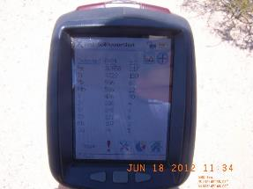
2.2 Task 2: background research
CERCLA Process
Elements of Sampling & Analysis, Work, and Health & Safety Plan
  Quality Assurance (QA)
  Quality Control (QC)
Available Lab Facilities & Test Methods
X-Ray Fluorescence (XRF) Technology
Ecological Risk Assessment
Human Health Risk Assessment
Figure 5. (Source: Plis, Matt BLM)
Audrey Lang

Slide 10
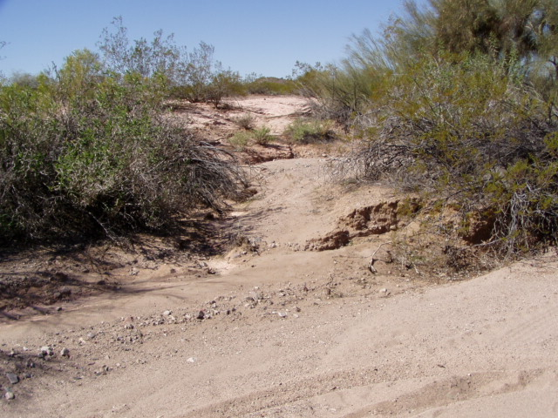
2.3 Task 3: Work Plan (WP)
A work plan details the protocols that will be followed when collecting samples
A Health & Safety Plan (HSP) and a Sampling & Analysis Plan (SAP) are included as appendices
Figure 6. (Source: Plis, Matt BLM)
Nicolas Boon

Slide 11

2.3 Task 3: work plan
2.3.1 HEALTH AND SAFETY (HSP)
  Hazardous encounters during site visit
  Safety plan to eliminate possible risks posed by hazards
  Online safety courses
Figure 7. (Source: OH Assist)
Nicolas Boon

Slide 12
2.3 Task 3: Work Plan
2.3.2 Sampling & Analysis Plan (SAP)
  Sample Selection Rationale
    100 samples will be taken
    Sample Locations (Based on grid method)
    Selection of Target Metals (Arsenic and Lead)
  Laboratory Testing Methods
    Metal Extraction Methods
    Testing Procedures
  Correlation Between Field Screening and Lab Results
  Data Validation
Nicole Stanczak

Slide 13
2.4 task 4: PA/SI
Final Deliverable
  Work Plan
    Health and Safety Plan
    Sampling and Analysis Plan
  Results
  Recommendations
Figure 8. (Source: Nixon, Nicole BLM)
Audrey Lang

Slide 14
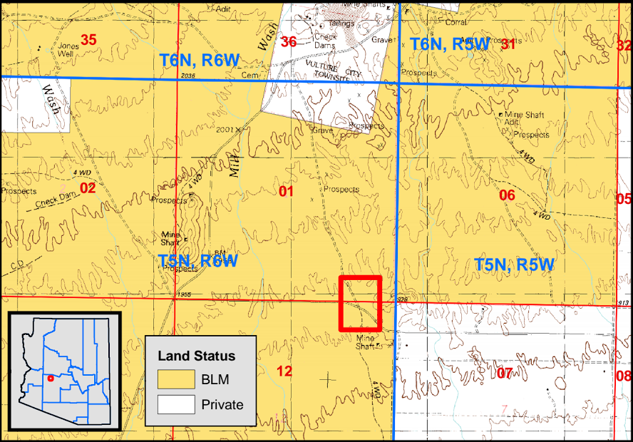
2.5 exclusions
The team will not be sampling in private property.
The team will not be addressing or providing remediation alternatives.
Figure 9. (Source: Plis, Matt BLM)
Nicolas Boon

Slide 15
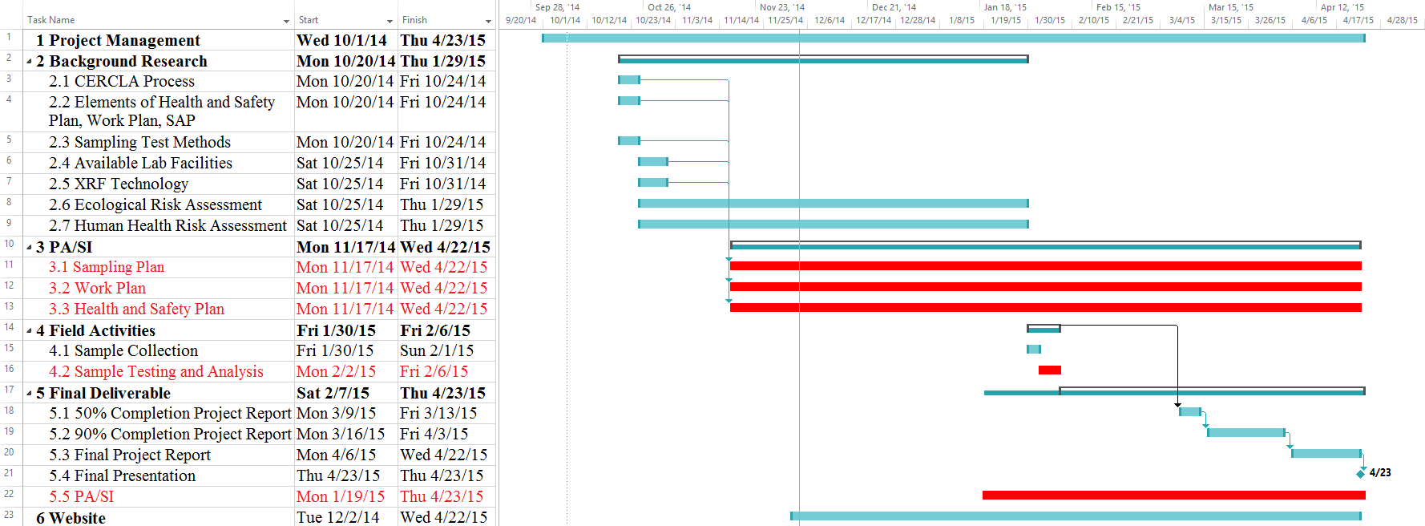
3. Project Schedule
Nicolas Boon

Slide 16

4. Cost of engineering Service
4.1 Staff Positions and Task Matrix
4.2 Cost of Engineering Services
Figure 10. (Source: VeryIcon)
Audrey Lang

Slide 17
4.1 Staff Positions and Task Matrix
The expected personnel working on the project are the senior engineer, environmental engineer, and lab technician
Task | SENG days | ENG days | LAB days
1.0 Project Management
2.0 1st Background Research |  | 9
3.0 Work Plan |  | 5
3.1 Health and Safety Plan |  | 5
3.2 Sampling Plan |  | 5
3.3 Sampling Collection | 2 | 2
3.4 Lab Analysis |  | 5 | 5
4.0 PA/SI |  | 14
6.0 Final Report | 10 | 30 |  | Total # of Days
Subtotal | 12 | 75 | 5 | 92
Audrey Lang

Slide 18
4.2 Cost of Engineering Services
The project costs are broken down into multiple categories
COST ESTIMATE
 | Classification | Hours | Rate $/hr | Personnel Cost | Cost
1.0 Personnel | SENG | 11*8=88 | $ 114.40 | $ 10,067.20 | -
 | ENG | 66*8/3=178 | $ 52.80 | $ 9,398.40 | -
 | LAB | 5*8=40 | $ 29.92 | $ 1,196.80 | -
 | Total Personnel |  |  |  | $ 20,662.40
2.0 Travel |  |  |  |  | $ 700.00
3.0 Subcontract | Analytical |  |  |  | $ 318.75
4.0 Supplies |  |  |  |  | $ 155.00
5.0 Overhead |  |  |  |  | $ 17,250.00
6.0 Total |  |  |  |  | $ 39,086.15
Nicolas Boon

Slide 19
Questions?

